Slide 1
Housing Market Exploration – Jefferson County
Graham Latsa

Slide 2
Purpose
Top 5 Rated Market (Zillow) “To outperform National Average”, this year and last year.
Top 10 Population Growth in both % and # (2019)
New “Green” Development
Current Economic Instability

Slide 3
Understanding the Data
Jeff. CO Housing Data
Median $ Price of Houses
https://propertysearch.jeffco.us/propertyrecordssearch/sales
1/1990 every 5 years to today
80k + records
Contains $ price, date, address
No GIS Data
https://fred.stlouisfed.org/series/MSPUS
Quarterly Data
http://data-jeffersoncounty.opendata.arcgis.com/datasets/address
Contains GIS Data
Address’s GIS Data

Slide 4
Data Goals
Growth
Units Sold
$ Increase
Seasonality
Price Fluctuations
Timing
Resilience
Recession Effects

Slide 5
Primary Tools Used
3 Focus Areas
Pivot Tables – Aggregating & Sorting Data
Automation – Webscrapping & Geo-Function
Heatmapping – Geoplotting

Slide 6
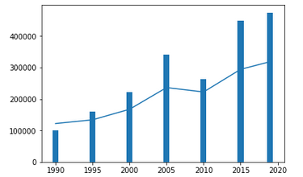
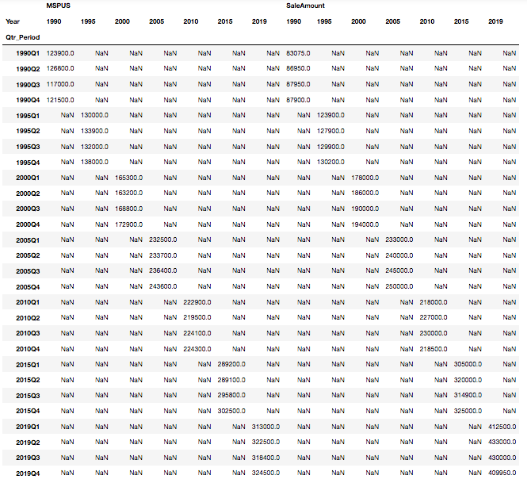
Understanding the Market – Jeff Co Vs. USA

Slide 7
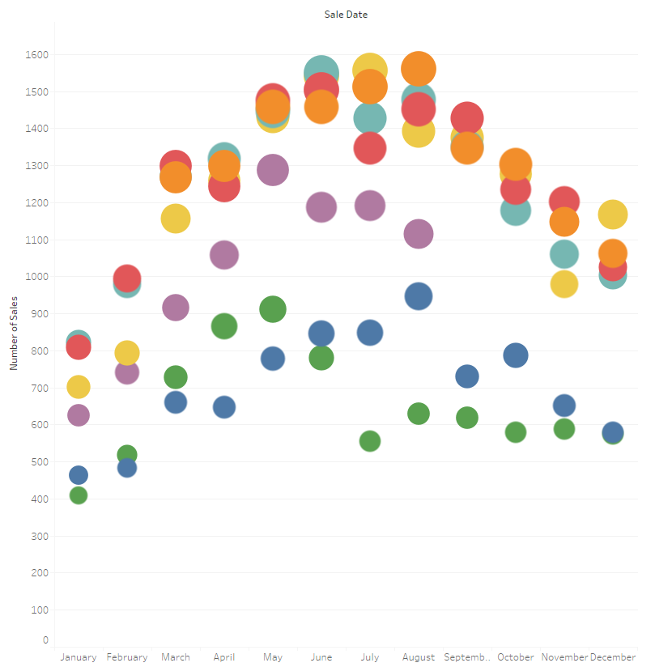
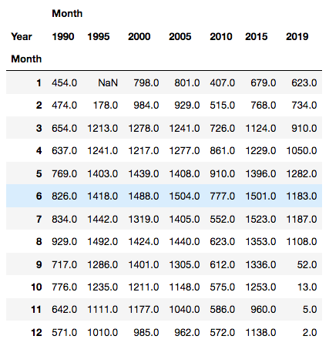
Understanding the Market - Seasonality

Slide 8
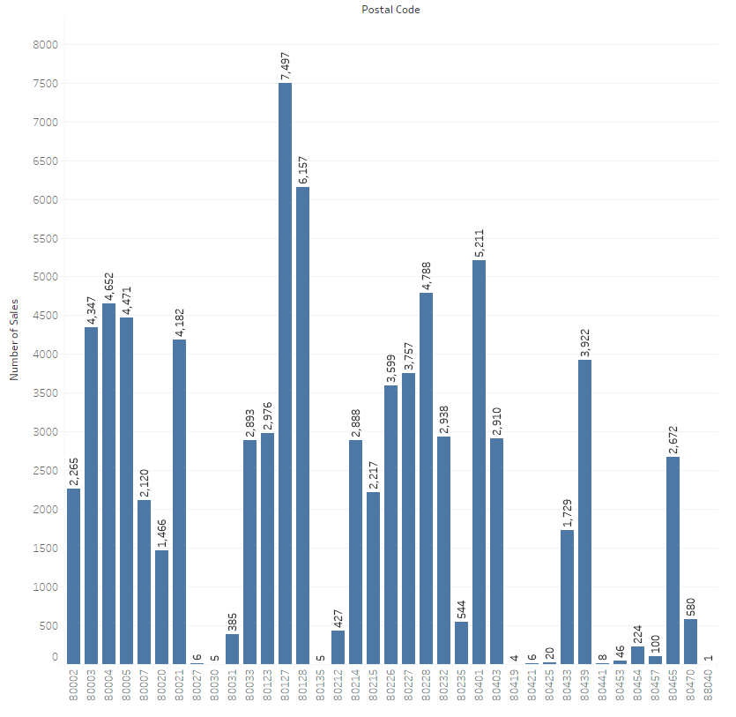
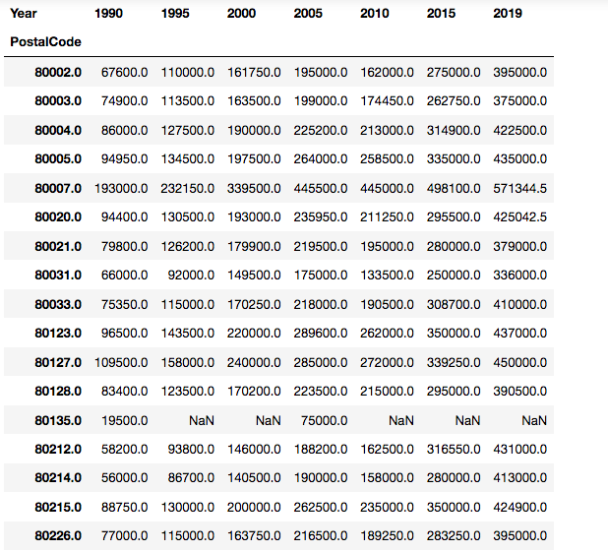
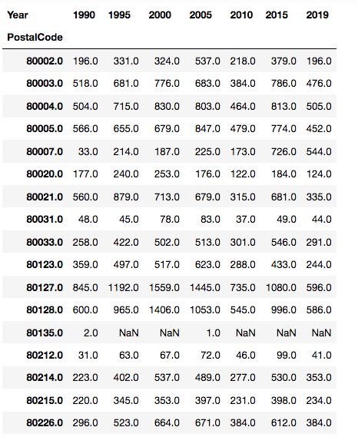
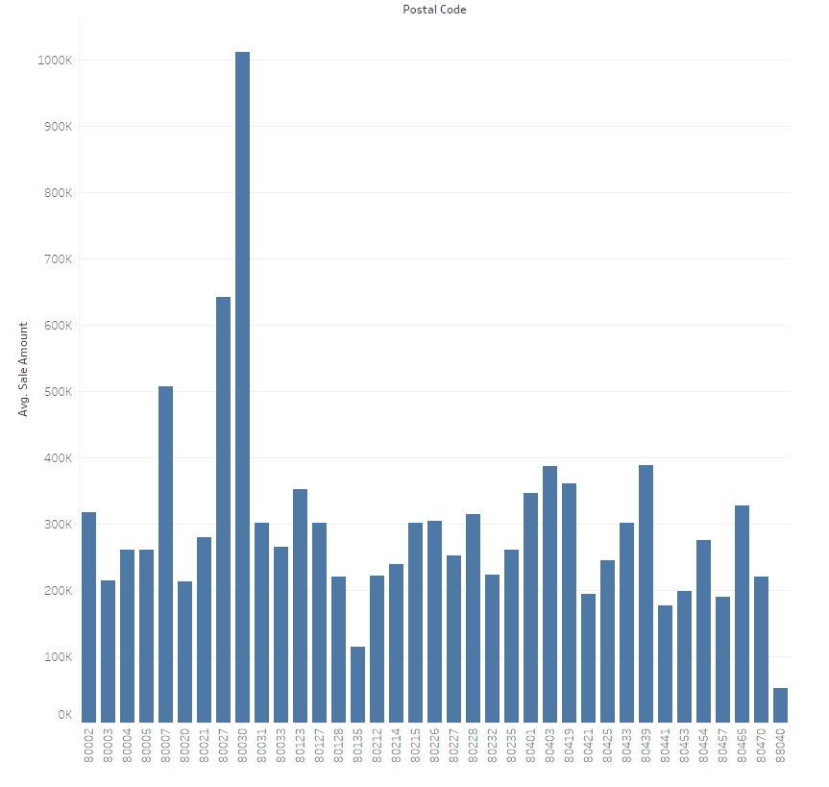
Understanding the Market – Supply & Demand

Slide 9
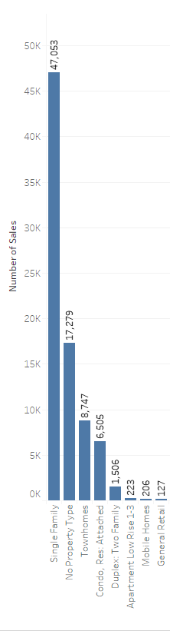
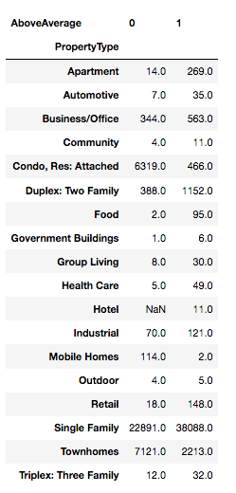
Understanding the Market – Top Selling Units

Slide 10
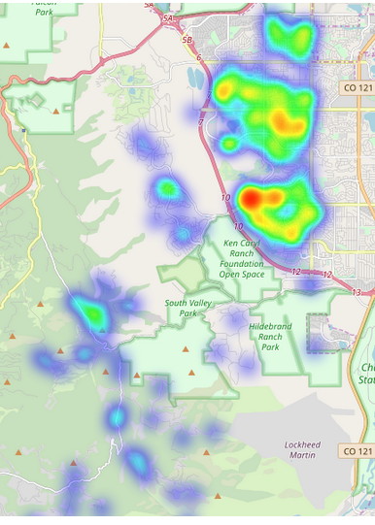
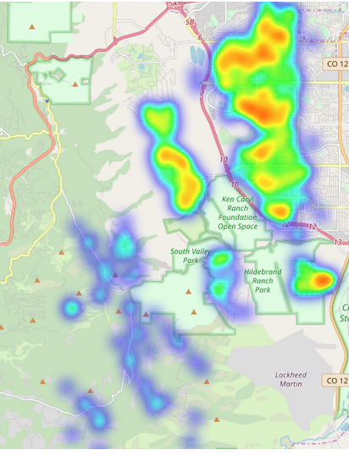
Geoplotting – Most Popular Zip Code
Houses Purchased Under the Median House Price
Houses Purchased Over the Median House Price

Slide 11
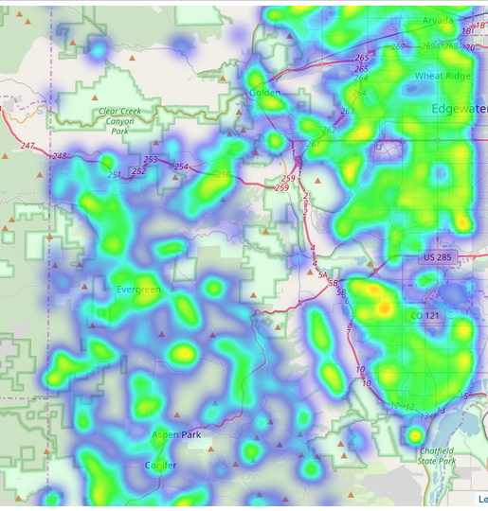
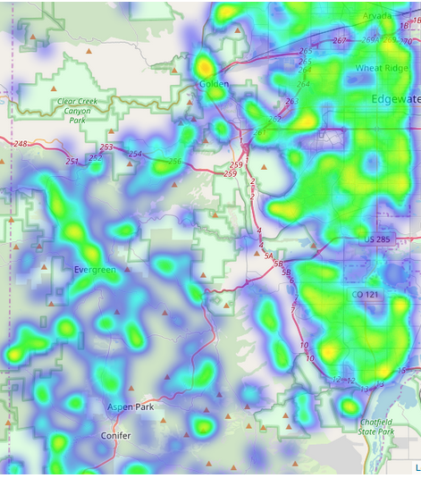
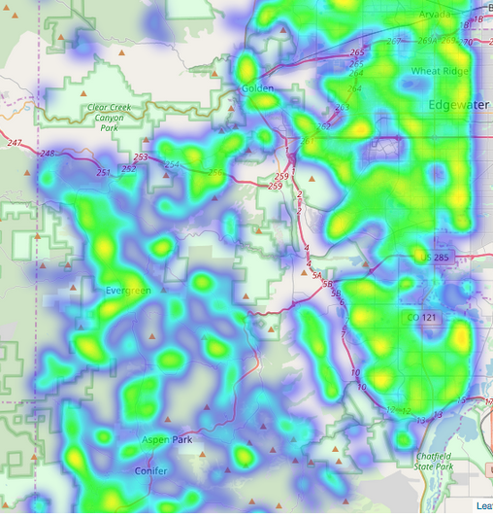
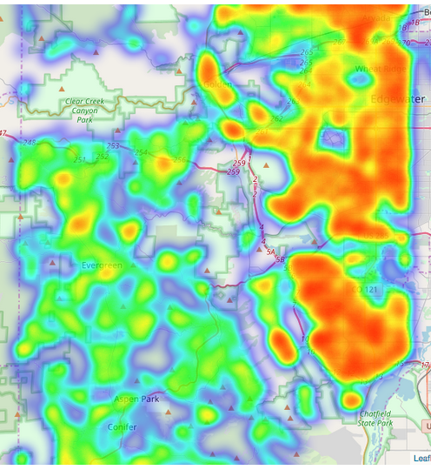
Geoplotting – Single Family Homes Over Time

Slide 12
WebScrapping
driver = webdriver.Chrome('/Users/gml/Downloads/chromedriver')
driver.get('https://propertysearch.jeffco.us/propertyrecordssearch/sales?saleAmountFrom=1&page=1&sortBy=pin&sortDirection=asc&saleAmountTo=100000')
time.sleep(10) # Let the user actually see something!
html = driver.page_source
soup = BeautifulSoup(html,"lxml")
headers = [c.get_text(strip=True) for c in soup.find_all('th')]
f_headers = []
for i in headers:
if i not in f_headers:
f_headers.append(i)
print(headers)
data = [[cell.get_text(strip=True) for cell in row.find_all('td')]
for row in soup.find_all("tr", class_=True)]
len(data)
20*
Not entire data set

Slide 13
Take Aways
Location, Location, Location
Mountain Pricing
Resilience
Seasonality – Summer or Christmas
Old Homes Sell (Pricing & Quantity)
Recession cut the Market in Half

Slide 14
Expansion
Use More Data
Rooms
Years
Multi Dimensionality
Use Less Data
Continue Developing Automation & Usability
Quicker Preprocessing and Error Checking

